Slide 1
Vocal for local (Drop Shipping)
Performed by:
Mihir Patel(19IT104)
Dharmik Patel(19IT094)

Slide 2
Introduction
Drop shipping sounds simple on the surface. It entails you setting up your own ecommerce shop and reaching out to suppliers who take your orders and ship those orders to your customers.
In short, it's designed so that you don't have to house any inventory, and you don't have to worry about any shipping costs or logistics.
the most significant difference between drop shipping and the classic way of operating is that you don't hold any product inventory. Instead, you only pay for it when the customer has already given you the money for the order.
This makes drop shipping one of the few business models where you don't need to spend money before the customer actually pays you, which minimizes a lot of your risks.

Slide 3
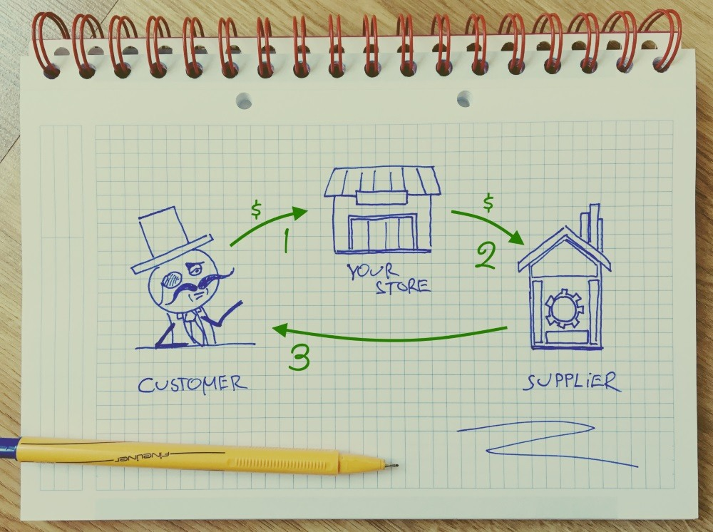
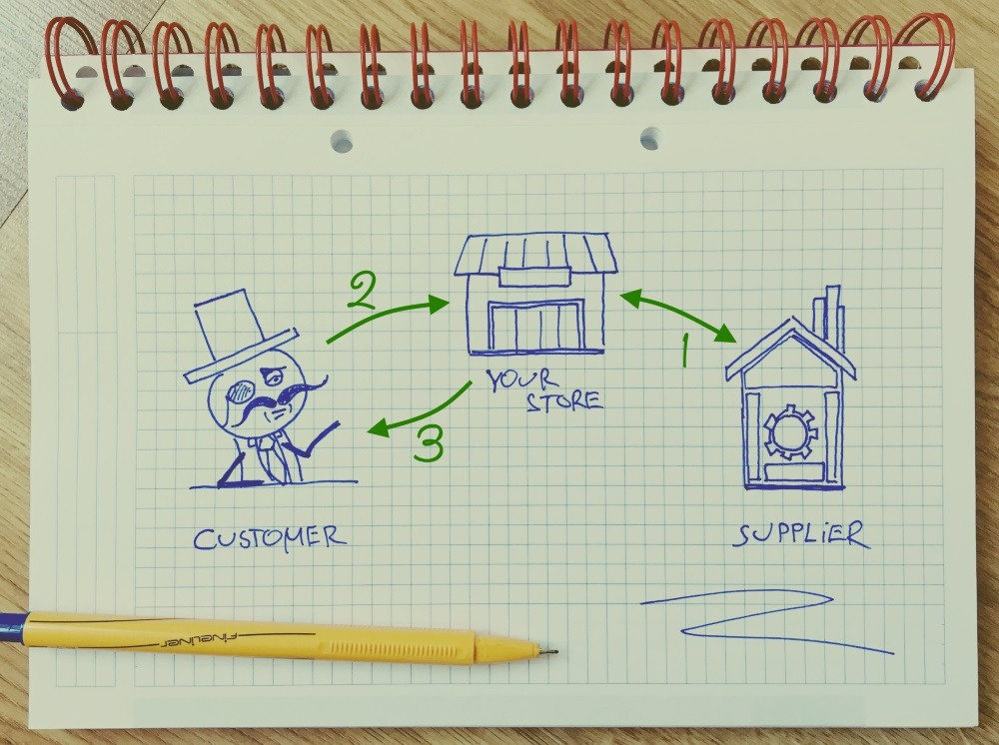
In the drop shipping scenario:
The customer pays you for the product.
(2) Only after you get the money from the customer, you pay the supplier to fulfill the order.
(3) The supplier sends the final product directly to the customer.
In the classic commerce model:
(1) You get the materials or the elements of the product from the supplier + at this stage you also need to pay the supplier.
(2) The customer pays you for the product.
(3) You send the product to the customer.

Slide 4
Milestone defined
Research on scenario
Front end Designing (50%)
Creating Database
Back end Coding

Slide 5
Pros and cons
Pros
Less risk
Very little overhead cost
A faster start-up
Scalable
Cons
Low-profit margins
Lots of inventory issues
Shipping is complicated

Slide 6
Our income
As per Quora Drop shipping profit much depends on what kind of products you are selling. It’s often a good idea to stick to low price with a high margin potential.
We recommend having a profit margin of 40%-70%. You can also try this formula that works well for our own Drop shipping projects:
$0<Supplier Price<$2=Your Price: $7.95. Your minimum profit: $5.95
$2<Supplier Price<$5=Your Price: $9.95. Your minimum profit: $4.95
$5<Supplier Price<$30=Your Price: Supplier Price x 2. Your profit: 50%
$30<Supplier Price<$50=Your Price: Supplier Price x 1.75. Profit margin: $22.5 -$37.5
For out Startup:
We can get a profit margin up to 5 to 10%.
After words We can provide monthly and yearly subscription for batter experience.

Slide 7
Methodology
Technology used
HTML5
CSS3
Java Script
Database [MYSQL or Firebase]

Slide 8

UN Sustainable development Goal

Slide 9
References
https://www.doba.com/
www.Aliexpress.com
https://en.wikipedia.org/wiki/Drop_shipping
https://www.w3schools.com/css/css_website_layout.asp
https://getbootstrap.com/

Slide 10
Conclusion
From our web app we can conclude that Drop Shipping is good business model for supplier chain management .
Through this customer can full fill there all need for day to day life.
Drop Shipping is a simplified and affordable way to get started in a business of your own.

Slide 11
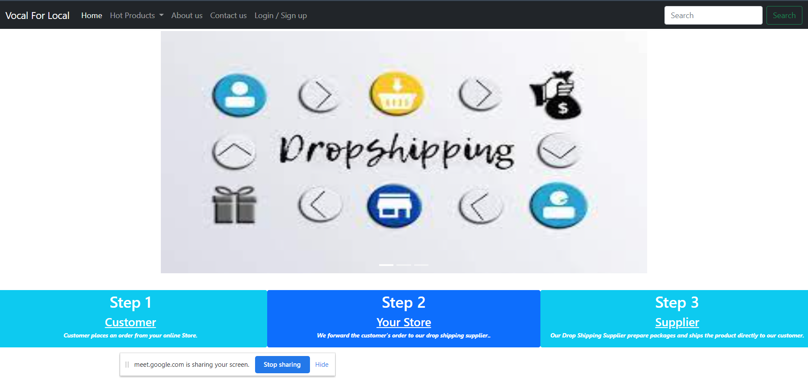

Slide 12
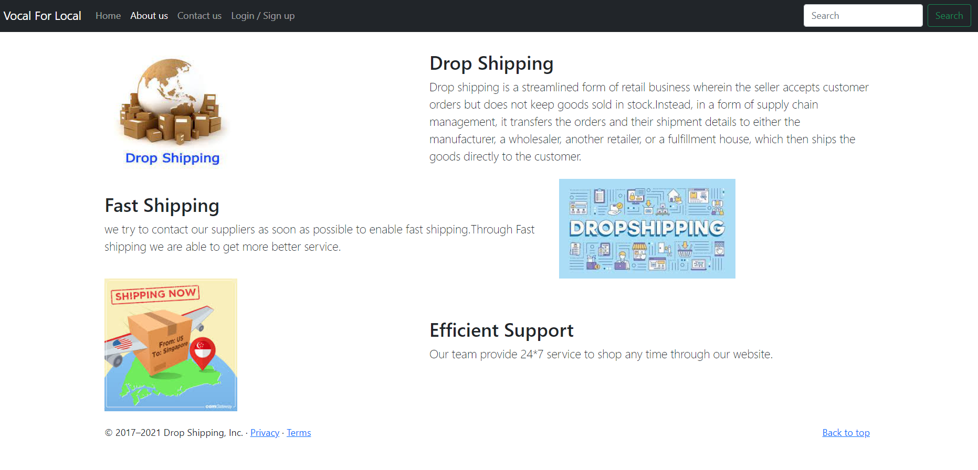

Slide 13
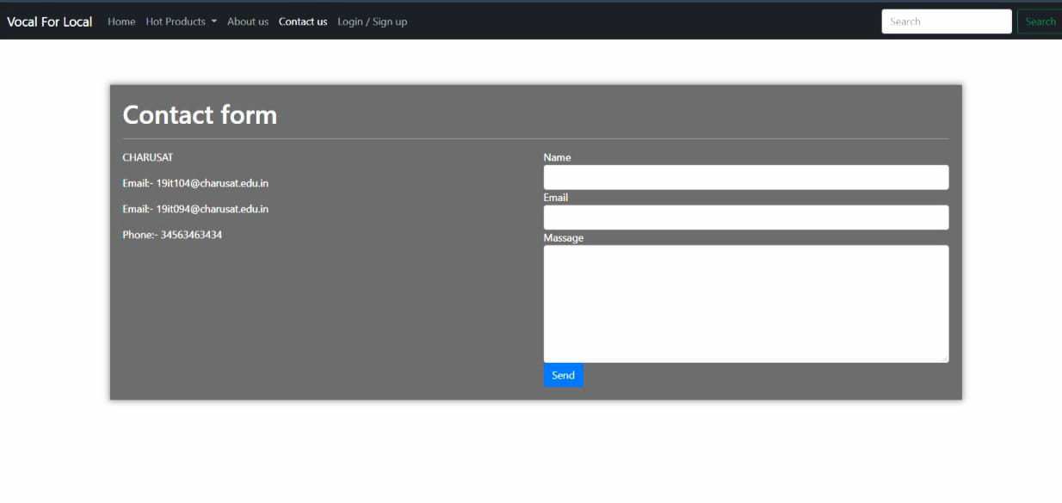

Slide 14
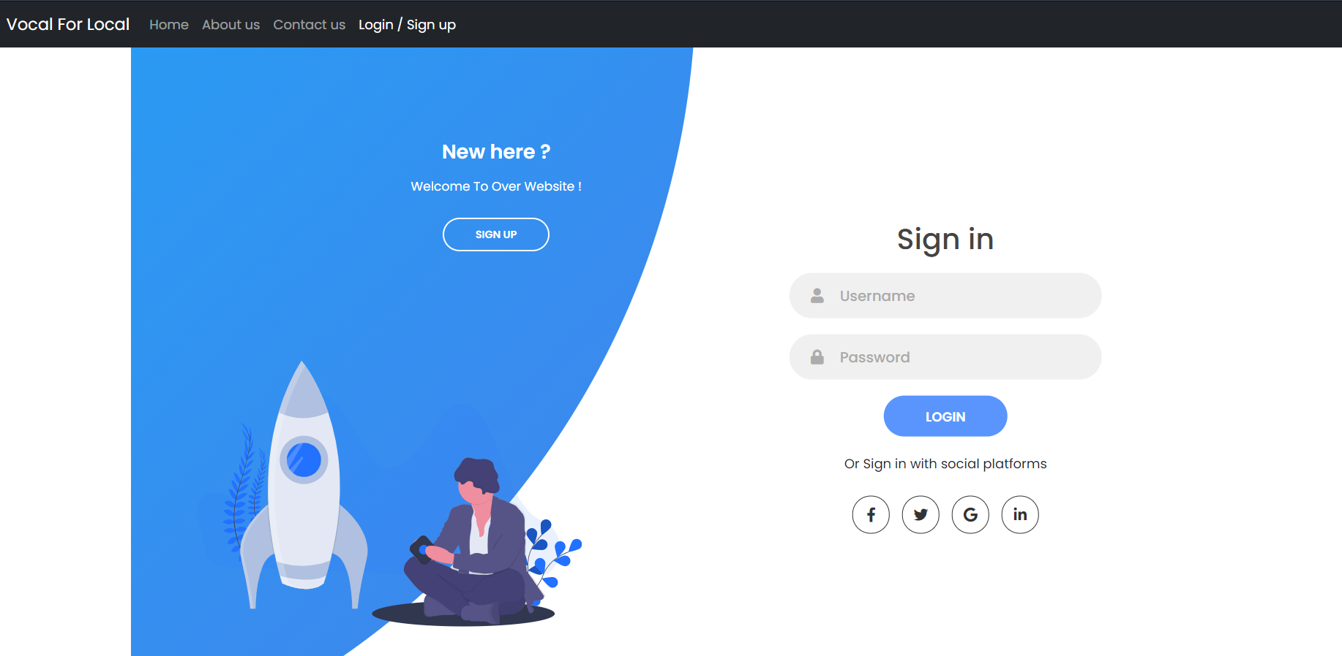

Slide 15
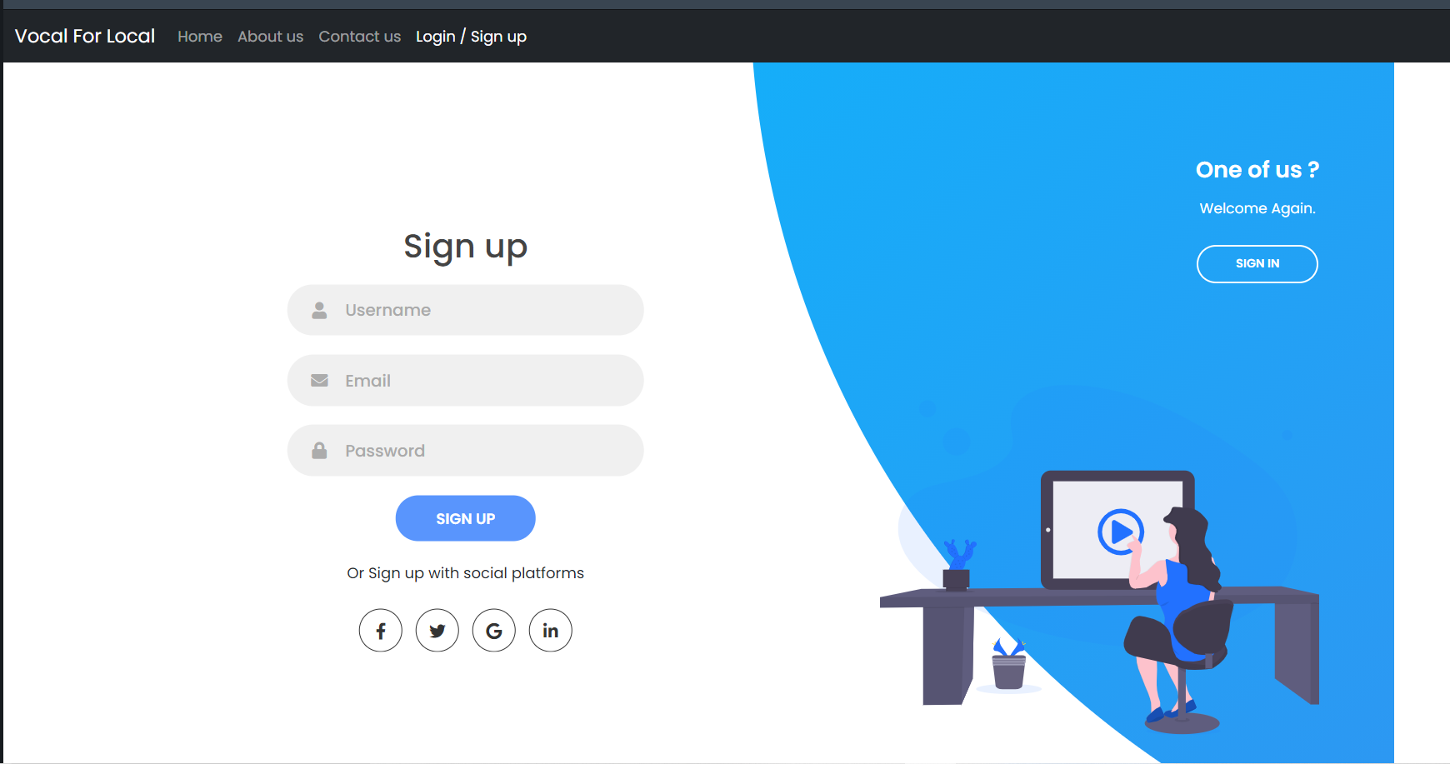

Slide 16
Thank you

